Slide 1

Credit Market Segmentation
22nd, August 2025

Slide 2


Outline
01
Introduction
02
Case Illustration
03
Exploratory Data Analysis (EDA)
3
04
Modeling and Prediction
05
Data-Driven Recommendation

Slide 3

Introduction
Why customer segmentation?
Customers are not homogeneous: They differ in income, needs, and repayment behavior.
Segmentation helps: Tailor credit products to needs, improve risk management, increase uptake and retention, and support financial inclusion strategies.

Slide 4

Explanatory Case
Credit Scoring
Financial institutions evaluate the creditworthiness of a borrower based on their past financial behavior and other characteristics.

Slide 5
Account Scorecard Example: Low Risk
Variable / Bins
Contribution
Score Allocation
0
<0.2
Average end of day account balance
0
51-100 USD
>1
0.8
1-50 USD
101-250 USD
251-500 USD
500+ USD
Ratio of money received vs sent
3+
1
2
Account Tenure (years)
25+
0
1-7
14-25
<1
7-14
<0.4
Days with 0 end of day balance on account in past month
100
130
110
100
Low
Medium
High

Slide 6
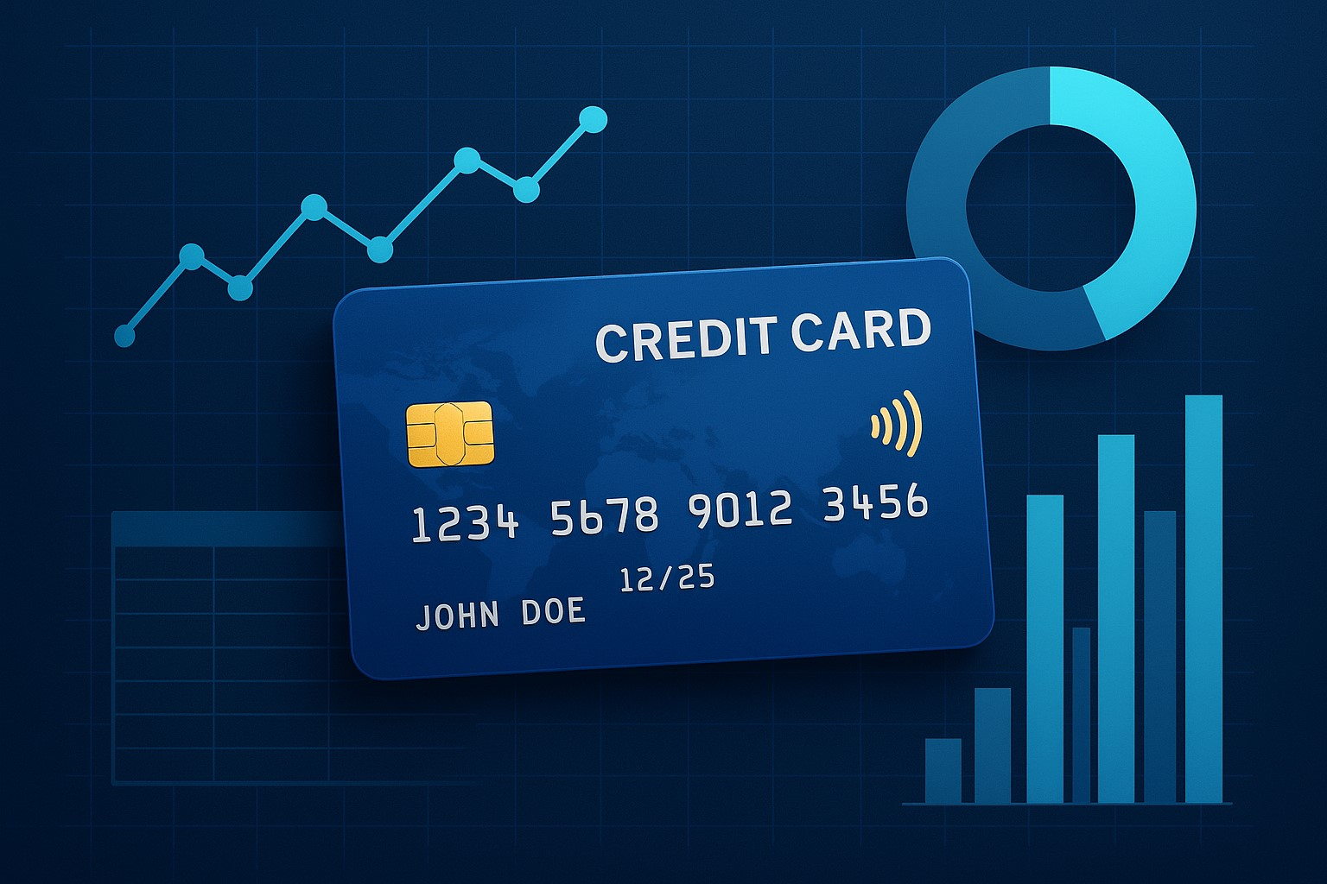
Practical
Case
Hands-on Case
Credit Card Default Data Analysis
This exercise covers EDA, segmentation, modeling, and prediction.

Slide 7
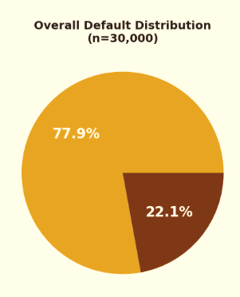
Overview & Dataset Summary
Dataset Info
Records | 30,000 Customers
Variables | 24
Target | Default payment
Table 1: Dataset Overview – Dataset Info
Key Statistics
Overall Default Rate | 22.1%
Total defaults | 6,636
Avg. Credit Limit | $167,484
Table 2: Dataset Overview – Key Stats

Slide 8
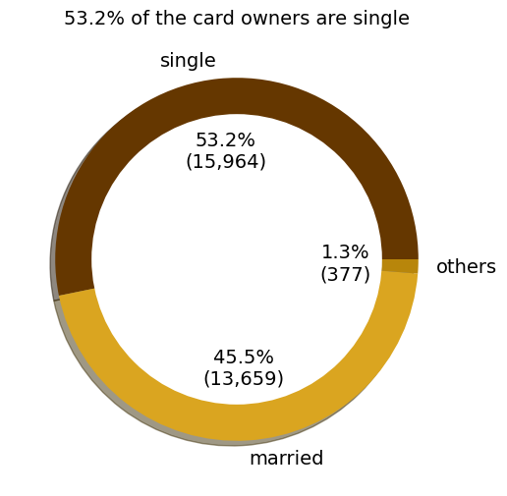
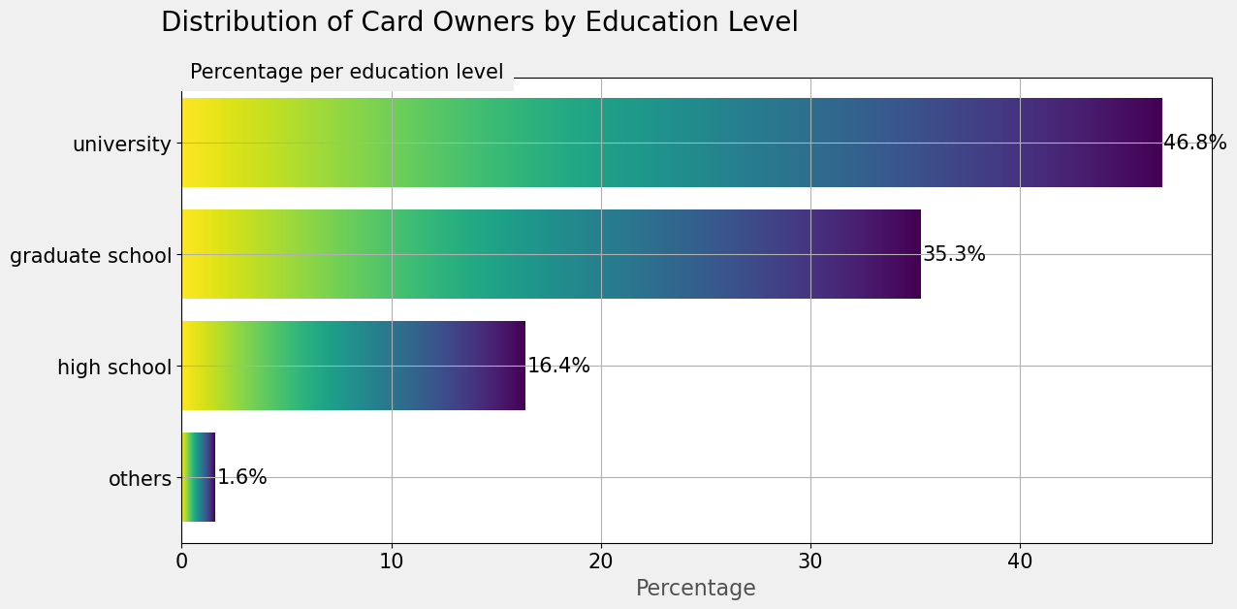
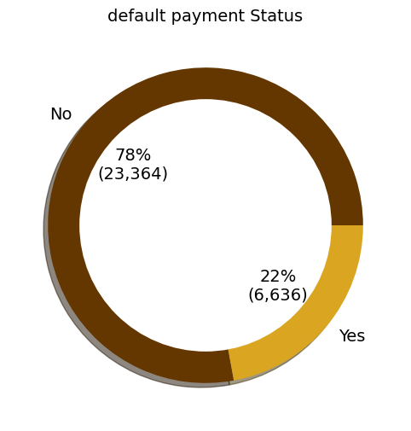
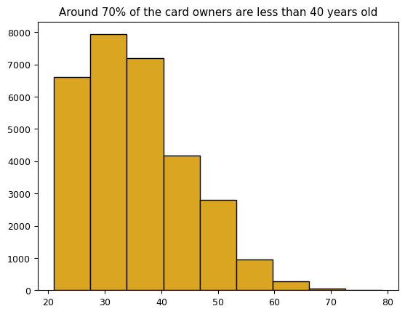
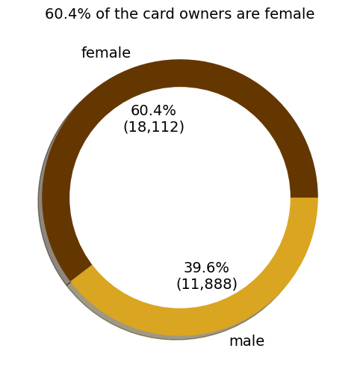
Key Variables Distribution
The report shows that people less than 40 years old with credit card are more than those above 40 years old. Moreover, the biggest group of those that have credit cards have university-level education. In addition, the number of credit cards issued to female is 1.5 times the number issued to Male. Generally, 22% of the loan were defaulted

Slide 9
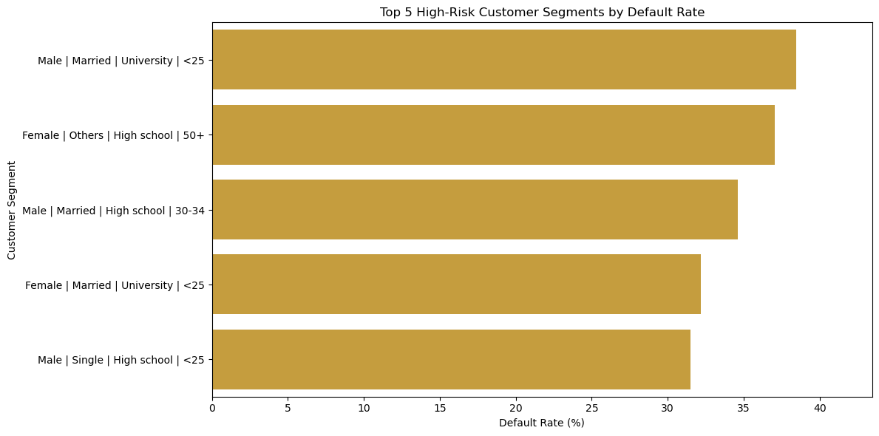
High-risk Customer Segments
Customer Segment definition
Sex (1 = male;2 = female)
Marriage (1 = married; 2 = single; 3 = others)
Education (1 = graduate school; 2 = university; 3 = high school; 4 = others).
Married males between 30-34 years old with high school education have the highest credit card default rate at 34.62%.

Slide 10
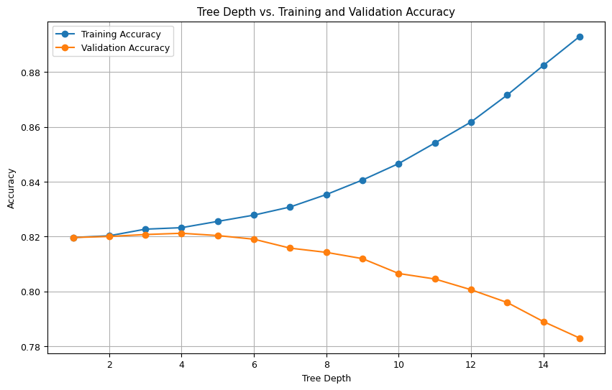
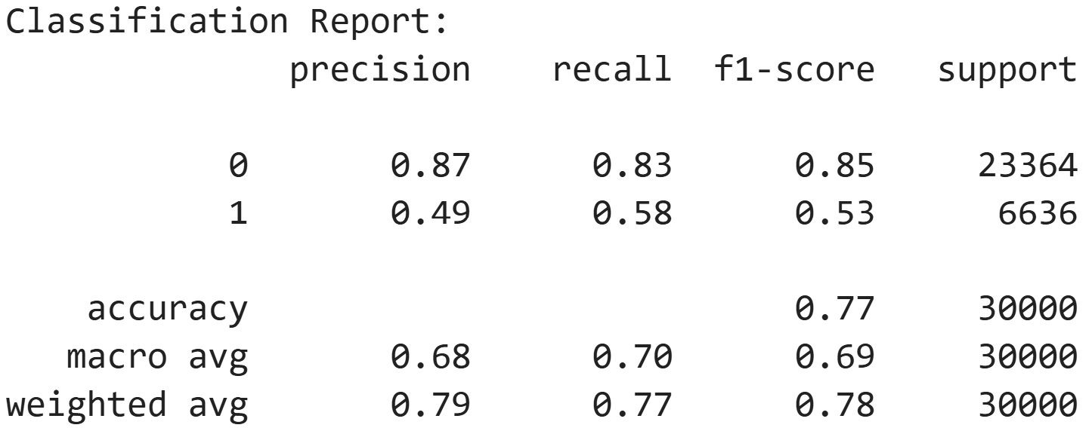
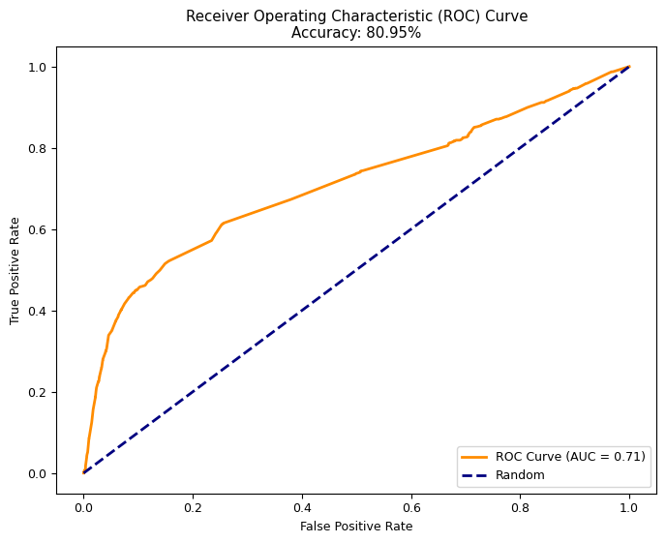
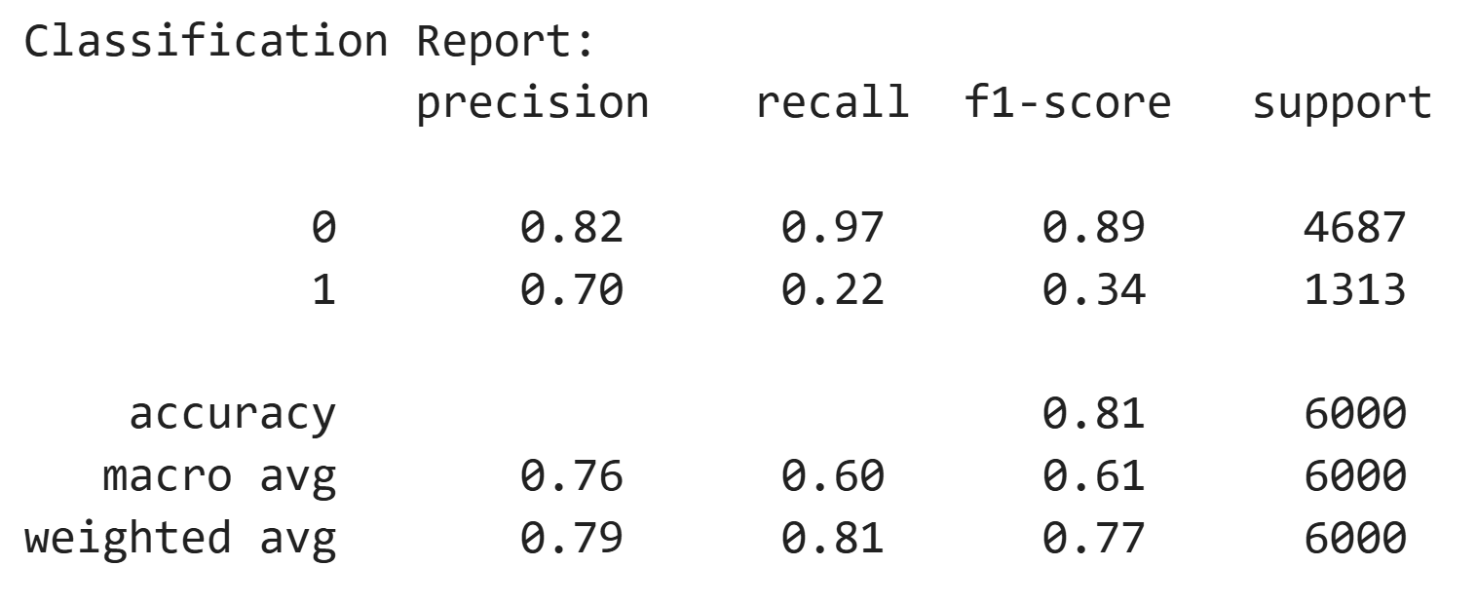
Modelling and prediction
Decision Tree
Logistic Regression

Slide 11
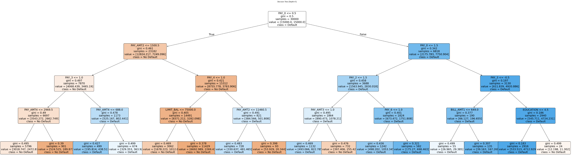
Decision Tree Classifier
High Default Risk
1. Pay0>=0.5,Pay0>1.5,Pay3>-0.5,Education<4.5
2. Pay1>=0.5,Pay>1.5,Pay3<-0.5,Bill_ATM1>649
3. PayO <0.5, Pay_ATM2<1500, Pay3>1, PAY_ATM4>688

Slide 12




What should be done?
Proactive Customer Support
Credit Limit Control
Monitoring & Alerts
Offer financial counseling
Reach out before default
Reduce or freeze limits temporarily
Behavior-based increases only
Track utilization & missed payments
Early-warning alerts at 70%, 85%, 95%.

Slide 13

Q&A
Contact Information

